Slide 1
Rotary Club of Wauseon
Members

Slide 2
Please note that due to the whimsy of a few of our members some of the images are incorrect and in fact copyrighted. Our special apologies go out to Peanuts Worldwide - Iconix Brand Group, and Clint Eastwood.
These members may be mocked or commended at your own discretion.

Slide 3
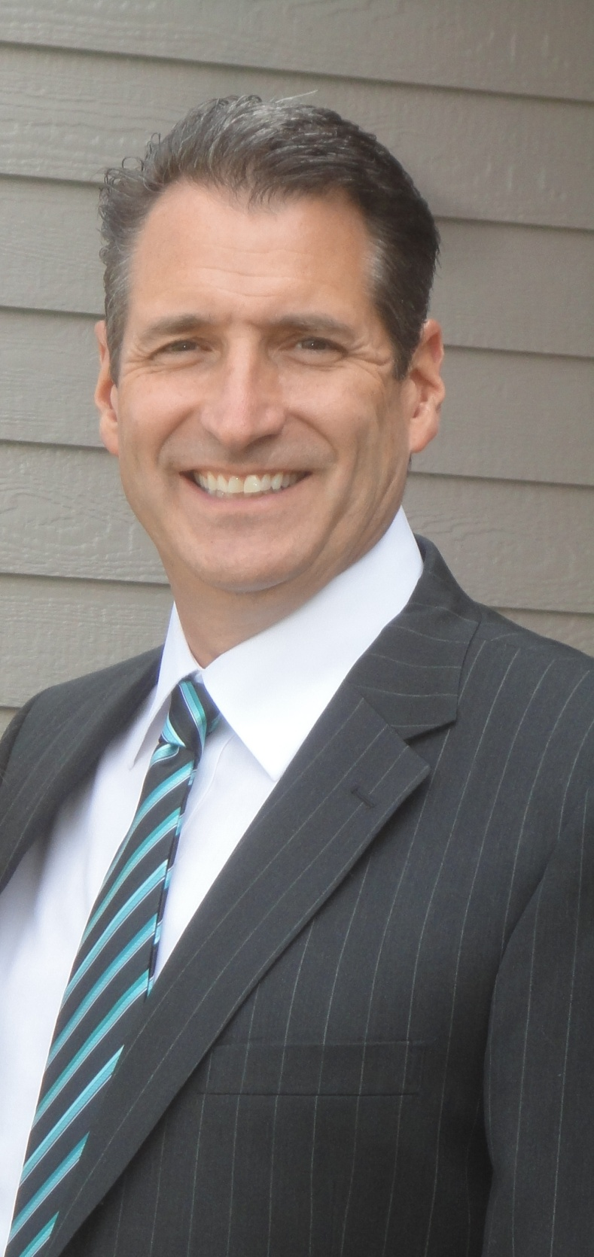
Scott Mirtes
Line of work | HL Fraas Company Owner
why would someone come to you | I am a Full Service Electrical / Mechanical Contractor
Hobby | Boating
Contact Information | 419.335.0703

Slide 4
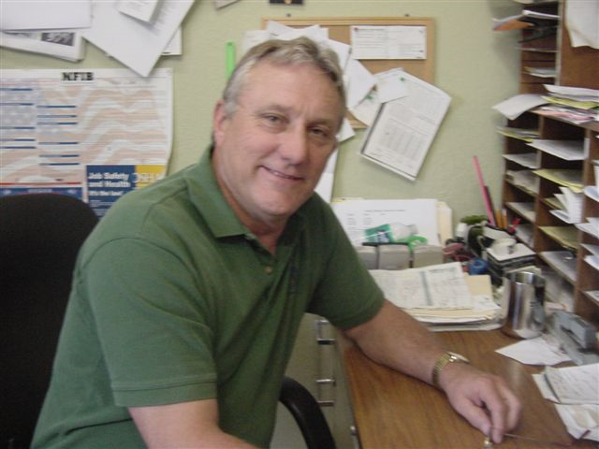
Greg Suon
Line of work
why would someone come to you
Hobby | golfing and fishing
Contact Information
Bio | Greg has been in business for 34 years having started Anything Grows Florist in 1977. He started Anything Grows Landscape in 1980 was joined by his son in 1990 and just this spring they sold the landscape business to FB Landscape. Greg's been married to Sherry for 36 years. He has 2 children, son Jason and daughter Jamie and 5 grandchildren.

Slide 5
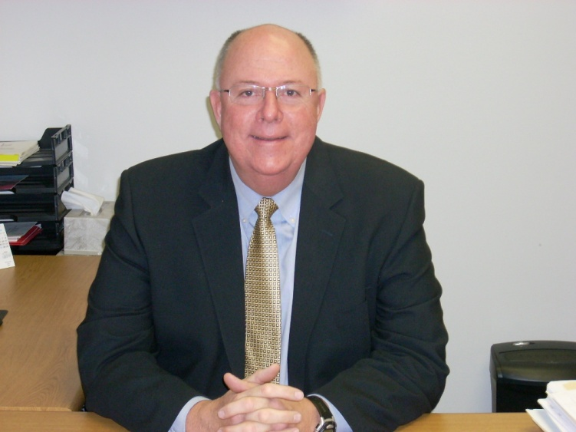
Marc Robinson
Line of work | Superintendent of Wauseon Exempted Village Schools
why would someone come to you | The Wauseon School District is the largest district in Fulton County and serves approximately 1,985 students in grades Pre K - 12. There are 140 certificated staff members and 75 support staff. The District has been rated EXCELLENT for the past 5 consecutive years and EXCELLENT WITH DISTINCTION for the past 2 consecutive years.
Hobby | watching my son participate in athletic and other school related activities, golfing, travelling.
Contact Information | e-mail me at mrobinson@wauseonindians.org or call the office at 419.335.6616

Slide 6
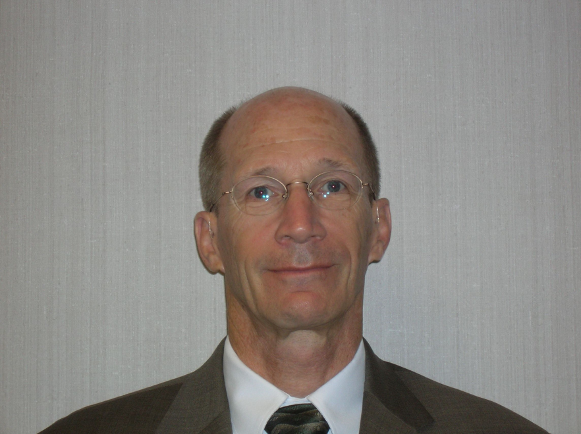
John rose
Line of work | I work at the F&M Bank
why would someone come to you | Banking
Hobby
Contact Information | Phone: 419.445.3501 ext. 02204 Fax: 419.335-0008

Slide 7
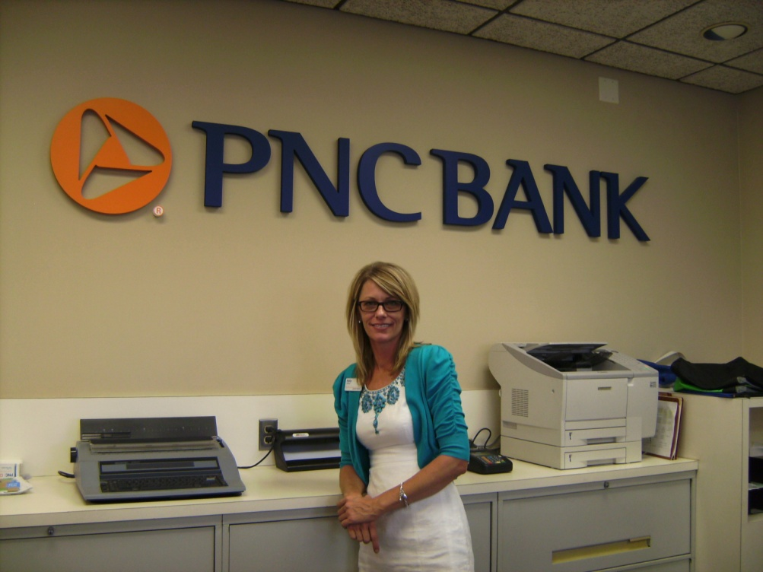
Kelly Rashley
Line of work | PNC Branch Manager Wauseon
why would someone come to you | Small Businesses and Consumer Banking
Hobby | snow skiing
Contact Information | kelly.rashley@pnc.com Phone: 419 335-2075

Slide 8
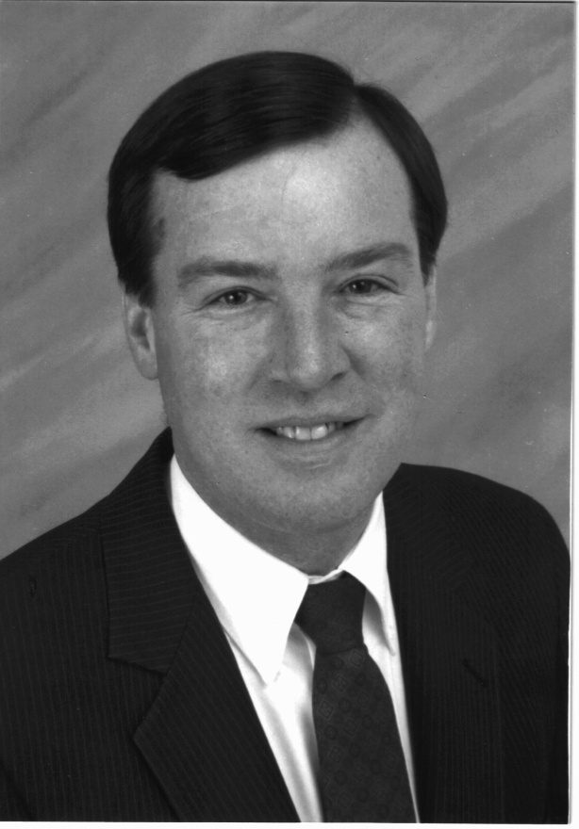
William Swigart
Line of work | Retired Fulton County Prosecuting Attorney
why would someone come to you
Hobby | Golf
Contact Information

Slide 9
Jeff Rupp

Slide 10
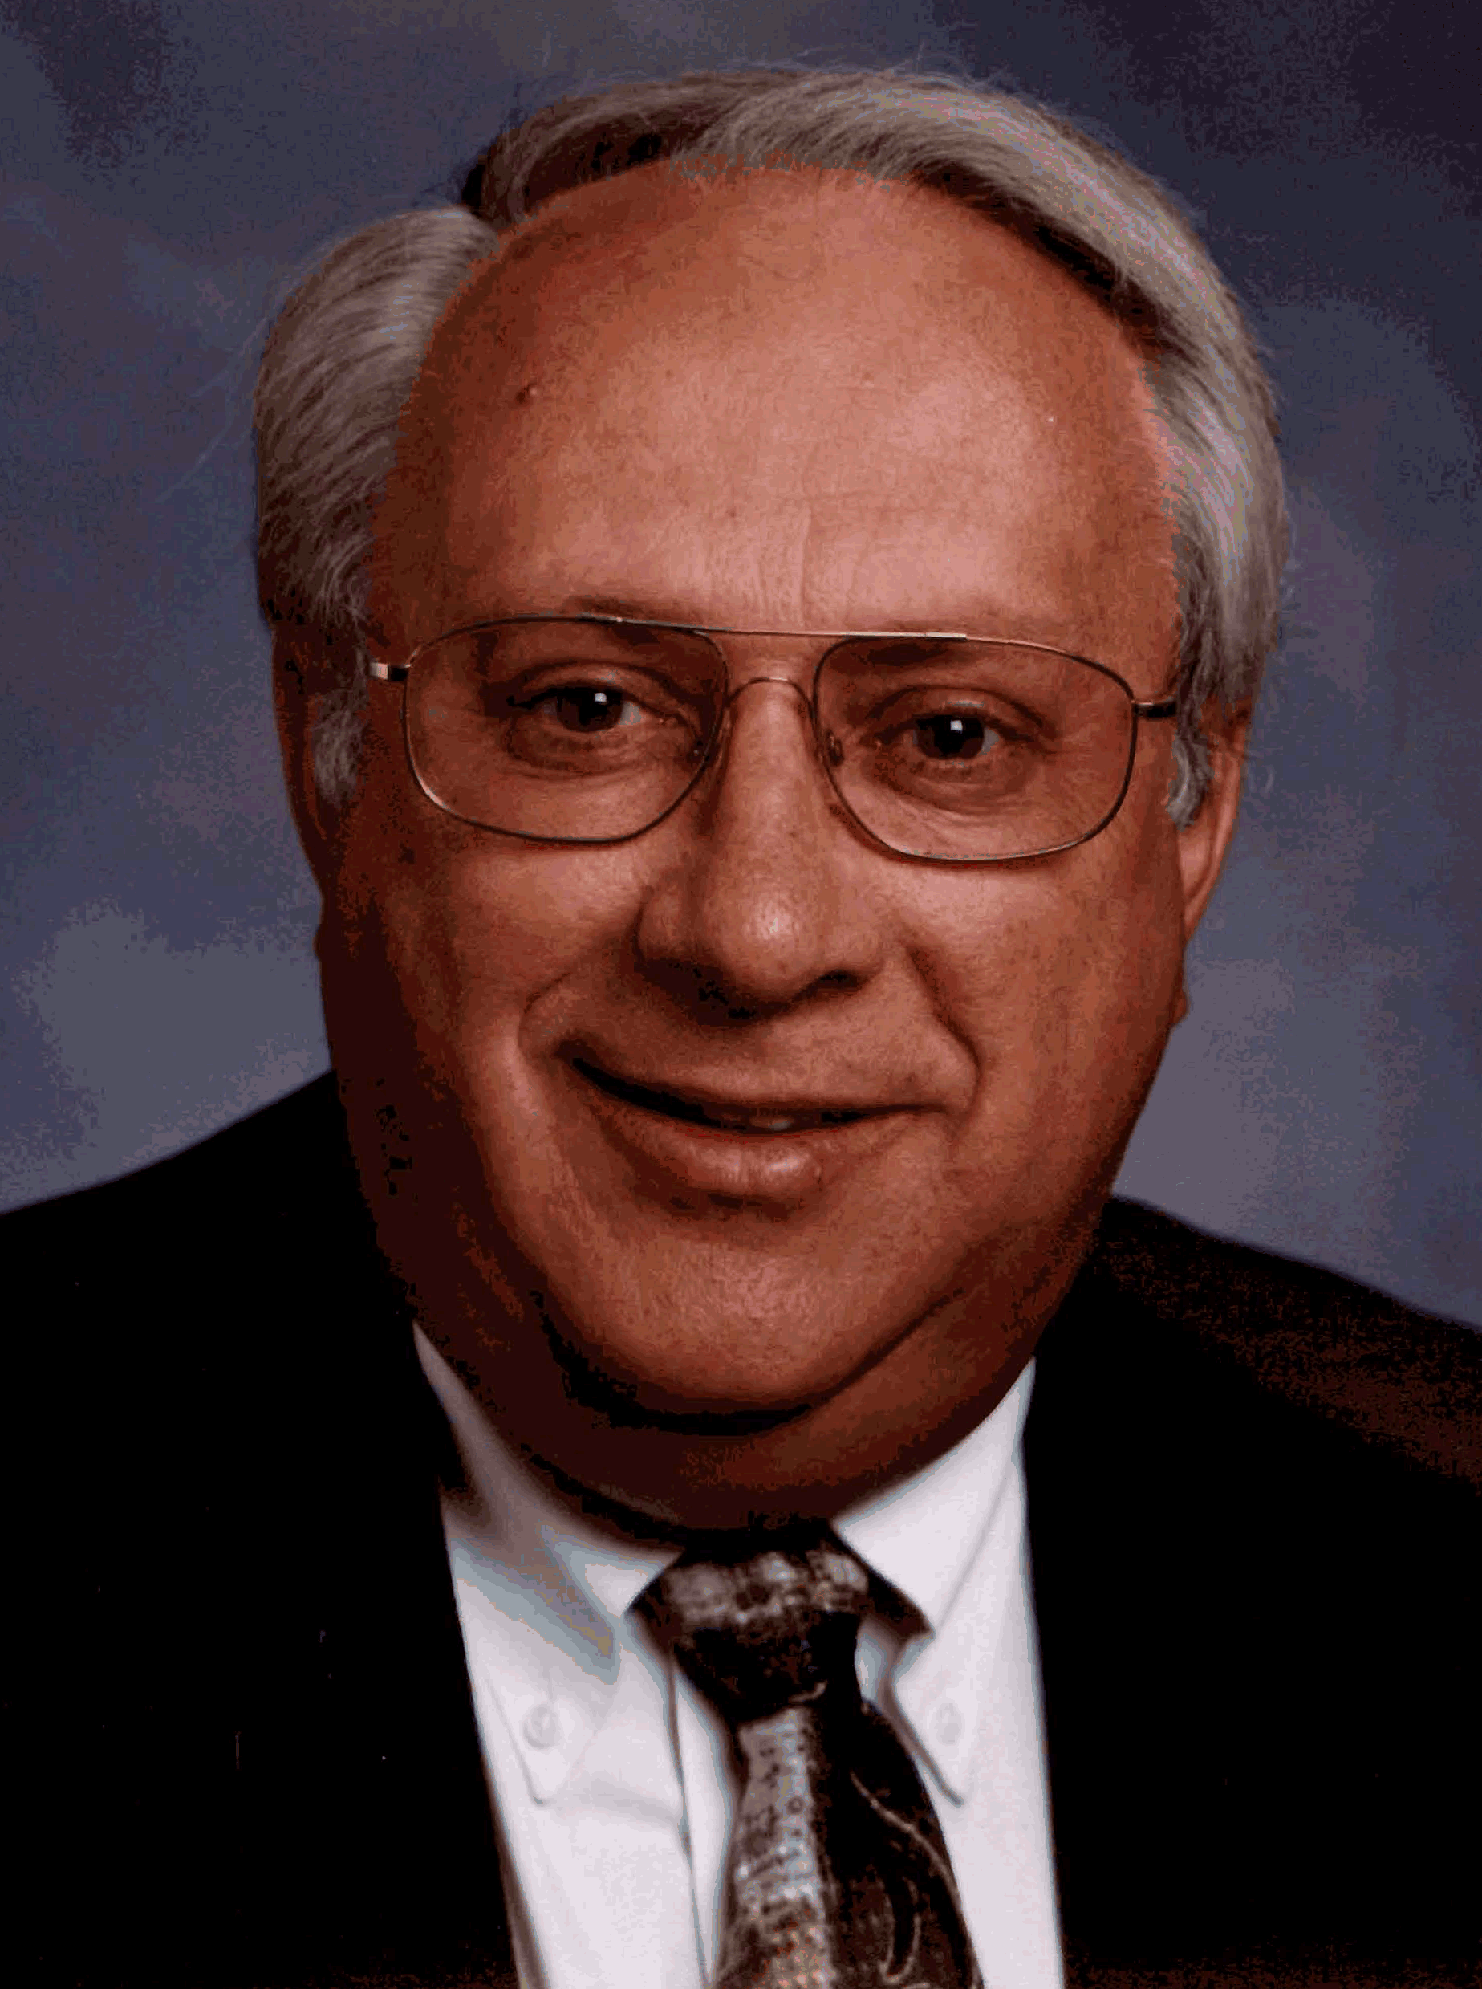
E. Dean Beck
Line of work | I am an administrator at the Fulton County Health Center. Responsible for the entire operation of the hospital, nursing home and physician offices .
why would someone come to you | If they are in need of health care
Hobby | Travel and golf
Contact Information

Slide 11
Shane Chamberlain
Line of work | Public Safety
why would someone come to you
Hobby
Contact Information

Slide 12
Jeff Robinson
Line of work | Partner at Barber, Kaper, Stamm ,Robinson & McWatters
why would someone come to you | Legal issues concerning Adoptions, Closings, Collections, Estate Law, Estate Planning, Family Law, Incorporations, Insurance Law, Power of Attorney, Trusts, Wills, Zoning
Hobby | Golf
Contact Information | 419 337- 5065; e-mail: jrobinson@bksr.org

Slide 13
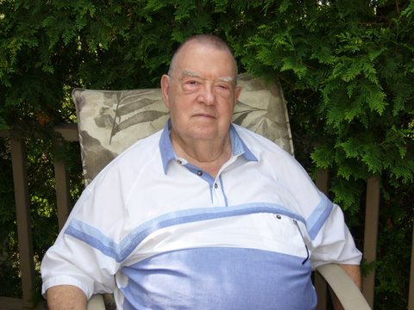
Bill Strayer
Line of work | Retired from banking in 1983 as Senior Vice Pres. after 36 years.
why would someone come to you
Hobby | Now Reading, Learning cooking and watching golf.
Contact Information

Slide 14
Larry Lammon II
Line of work | President of Wayne Lammon and Sons Inc.
why would someone come to you | Dealing with Office Space for rent and Used Cars
Hobby
Contact Information | 419-335-7700

Slide 15
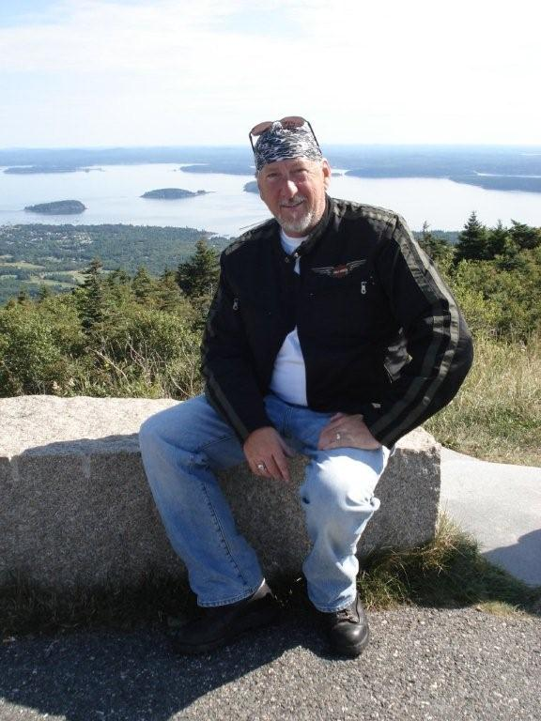
Gary Keyes
Line of work | Area Manager at Toledo Edison/ A First Energy Company
why would someone come to you | Work with Government Officials from Williams, Fulton and Defiance Counties....deal with Street Lighting, Media Relations, Economic Development, Billing Issues, and other issues
Hobby | 419-249-4156
Contact Information | motorcycle riding

Slide 16
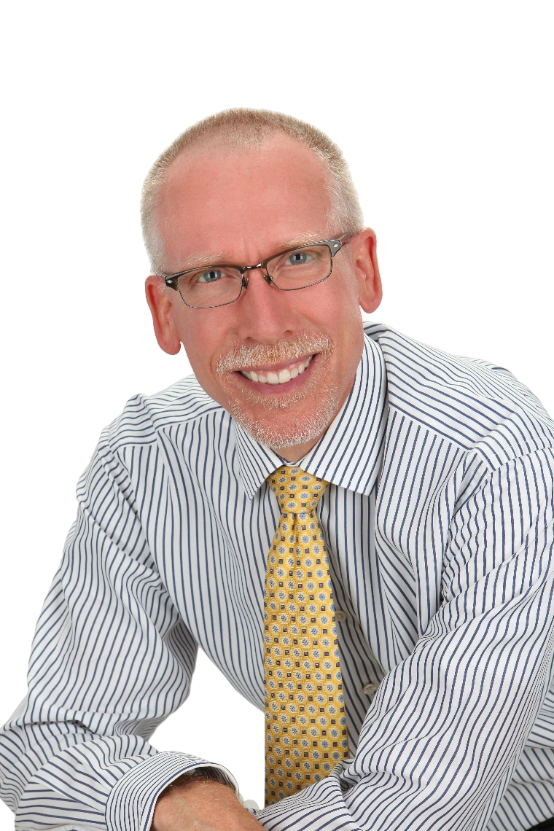
Dr. James Williams
Line of work | Owner and Treating Physician of Tri-County Chiropractic Clinic
why would someone come to you | I treat neck and back injuries as well as other musculoskeletal injuries. I perform DOT physicals and Sports physicals. My clinic includes a well equipped physical therapy suite. I specialize in neurology and perform advanced nerve testing in the form of needle EMG’s and NCV’s. In addition, I have advanced training in the treatment of Childhood Neurobehavioral Disorders to include ADHD, OCD, Autism, and Aspergers.
Hobby | Play electric bass and drums in a band called “Linden Street”.
Contact Information | Phone: (419)335-2225 Website: www.jameswilliamsdc.com

Slide 17
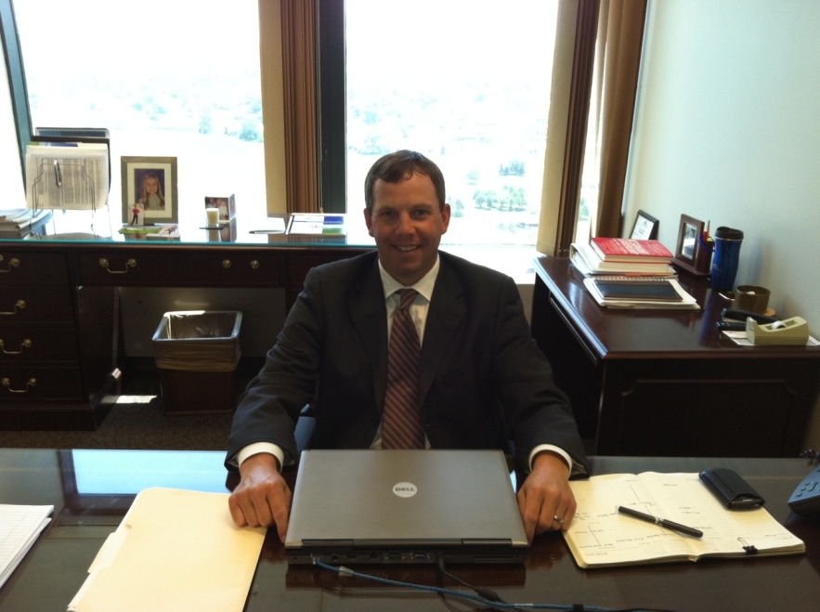
David Gerken
Line of work | Vice President Corporate Banking Division
why would someone come to you | Assist companies with their banking needs.
Hobby | (419) 259-7154
Contact Information | Enjoy playing golf and spending time with family

Slide 18
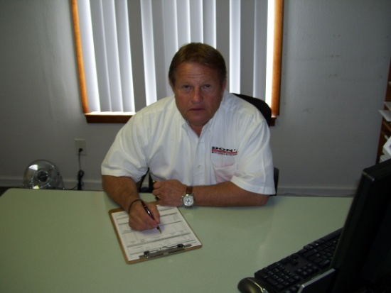
Rich Shemak
Line of work | Quality Control Manager at Don’s Automotive Group
why would someone come to you | New and Used Sales and Leasing
Hobby | Rotarian since 2010
Contact Information | Phone: 419-337-3010 Cell: 419-349-4882

Slide 19
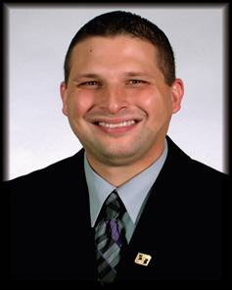
Brian Hageman
Line of work | Fifth Third Bank / Mortgage Lender
why would someone come to you | Lend money to people who wish to buy homes
Hobby | Family, golfing
Contact Information

Slide 20
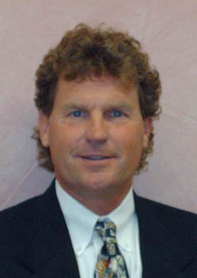
Mike Murry
Line of work | Broker and Auctioneer at Whalen Realty & Auction
why would someone come to you
Hobby | in the real estate and auction business for 24 years and a Member of the United States Tennis Association
Contact Information | Phone: 419-337-7653 Cell: 419-262-6943

Slide 21
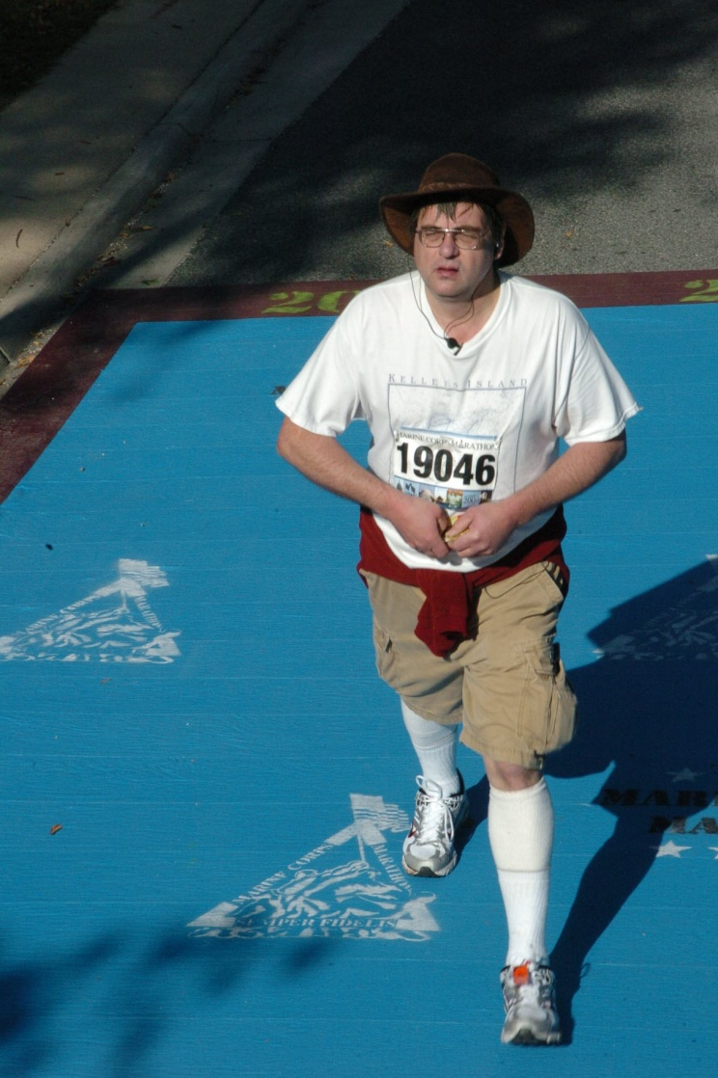
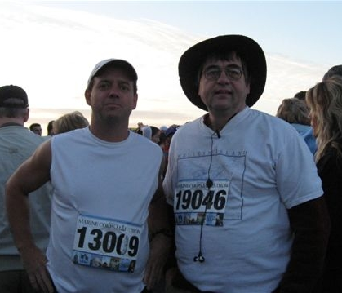
Tim Dennis
Line of work | Potato Packaging and Homes
why would someone come to you | Potato crisis within 500 mile radius of Wauseon or a great place to live in Fulton County
Hobby | Marathons and Travel
Contact Information | 419-335-2778 Emergency Line: 419-467-1524

Slide 22
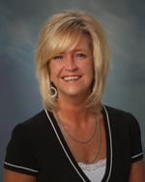
Robin K Brinegar
Line of work | Certified Public Accountant at Shultz Huber & Associates
why would someone come to you | Accounting, Bookkeeping, Tax Preparation, Business Valuations, and Business Advisors
Hobby | Gardening, Baking and a Cat Lover
Contact Information | 419-445-2000 www.sha-cpa.com

Slide 23
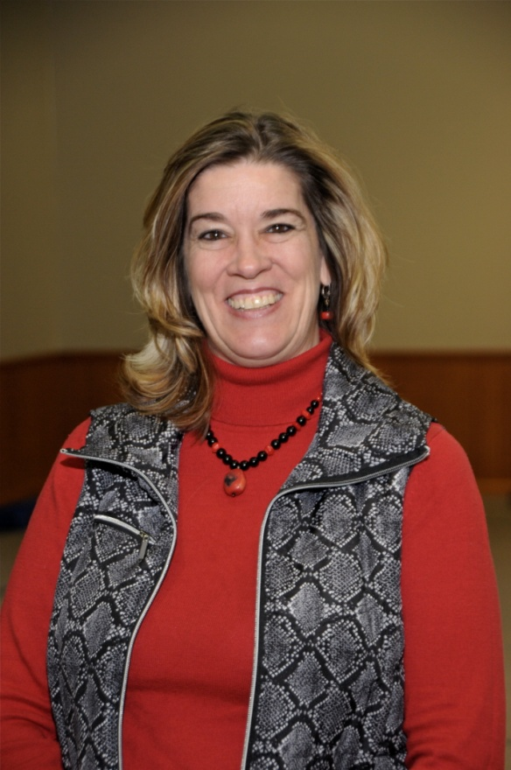
Robbin Wilcox
Line of work | Foundation Director of Development at Northwest State Community College
why would someone come to you | Fundraising-Securing donations on behalf of the NSCC to be used for various projects such as scholarships, Allied Health Building, equipment and other needed projects.
Hobby | I love to work in my gardens
Contact Information | rwilcox@northweststate.edu 419-267-1460

Slide 24
Name |  | City | State | Zip Code | Home Phone | Office Phone | Status | Active Date | e-mail
Beck, E. Dean |  | Archbold, | Ohio | 43502 | 419-445-3721 | 419-335-2015 | Active | 5/1/1982 | edean@bright.net
Brenner, Roger |  | Wauseon, | Ohio | 43567 | 419-337-8366 | 419-335-2743 | Active | 12/10/1997 | RB43567@yahoo.com
Brinegar, Robin |  | Fayette, | Ohio | 43521 |  | 419-445-2000 | Active | 11/21/2007 | robin.brinegar@sha-cpa.com
Chamberlin, Shane |  | Wauseon, | Ohio | 43567 | 419-335-3390 | 419-337-9236 | Active | 10/12/2008 | chamberlin2669@emarqmail.com
Darnell, Brant |  | Wauseon, | Ohio | 43567 | 419-335-9929 | 419-599-8045 | Active | 7/12/2006 | bdarnell@penrodcpa.com
Dehnbostel, Jerry |  | Wauseon, | Ohio | 43567 | 419-337-8135 | 419-335-3161 | Active | 1/31/1989 | dehn@embarqmail.com
Dehnbostel, Tony |  | Wauseon, | Ohio | 43567 | 419-337-7114 | 419-822-7233 | Active | 12/3/2003 | info@tomahawkprinting.com
Dennis, Tim |  | Wauseon, | Ohio | 43567 | 419-467-1524 | 419-335-2778 | Active | 3/2/2005 | mrsdennisinc@embarqmail.com
Dixon, Morvin |  | Wauseon | Ohio | 43567 |  |  | Active
Ferreira, Delle |  | Montpeiler | Ohio | 43567 | 419-459-4395 | 419-335-3802 | Active | 12/4/2002 | BassFish@Frontiernet.net
Frank, Patrick(Bill) |  | Wauseon, | Ohio | 43567 | 419-337-4311 | 419-335-8000 | Active | 8/1/1995 | bfrankdc@embarqmail.com
Garmenn, Darrel W. |  | Archbold, | Ohio | 43502 | 419-445-4317 | 419-466-5587 | Sr.Active | 11/1/1983
Gerken, David |  | Wauseon, | Ohio | 43567 | 419-344-0033 | 419-344-0033 | Active | 7/5/2006 | david.gerken@53.com
Hageman, Briam |  | Wauseon | Ohio | 43567 | 419-335-1664 | 419-335-2907 | Active | 7/1/2010
Haselman, Scott |  | Swanton | Ohio | 43558 |  | 419-249-7900 | Active | 3/17/2008 | shaselman@rcolaw.com
Hayati, Don |  | Wauseon, | Ohio | 43567 | 419-335-4098 | 419-337-3010 | Active | 8/9/2000 | privatemail01@embarqmail.com
Kahrs, Brett |  | Wauseon, | Ohio | 43567 | 419-591-8298 | 419-446-2900 | Active | 5/24/2000 | brett.kahrs@lpl.com
Kennedy, Paul |  | Archbold, | Ohio | 43502 | 419-277-0449 | 419-337-9240 | Active | 4/6/2005 | phkenn@adelphia.net
Keys, Gary |  | Archbold, | Ohio | 43502 | 419-262-0067 | 419-249-4156 | Active | 2/1/1995 | gwkeys@firstenergycorp.com
LaBarge, Greg |  | Wauseon, | Ohio | 43567 | 419-335-0114 | 419-337-9210 | Active | 5/1/1994 | labarge.1@osu.edu
Lammon, Larry II |  | Wauseon, | Ohio | 43567 | 419-337-0394 | 419-335-7700 | Active | 11/1/1989 | lammonii@centurylink.net
Lantz, Allen G. |  | Wauseon, | Ohio | 43567 | 419-337-8985 | 419-446-2501 | Active | 2/1/1983 | aglantz@embarqmail.com
Leupp, Kenneth (Skip) |  | Archbold, | Ohio | 43502 | 419-445-4919 | 419-572-1507 | Active | 11/1/1992 | skipliz@adelphia.net
Lopez, Ruben |  | Wauseon | Ohio | 43567 |  | 419-335-6299 | Active | 12/15/2010
McWatters III, Tom |  | Wauseon, | Ohio | 43567 |  | 419-337-5065 | Active | 12/12/2007 | tmcwatters@bksr.org

Slide 25
Name |  | City | State | Zip Code | Home Phone | Office Phone | Status | Active Date | e-mail
Mirtes, Scott |  | Wauseon | Ohio | 43567 |  | 419-335-0703 | Active | 11/24/2010
Murry, Michael W. |  | Wauseon, | Ohio | 43567 | 419-335-0942 | 419-337-7653 | Active | 10/2/1996 | mwmurry@earthlink.net
Newcomb, Tracey |  | Wauseon | Ohio | 43567 | 419-335-0842 | 419-335-4451 | Active | 3/10/2010 | newk86@msn.com
Nofziger, Ed |  | Archbold, | Ohio | 43502 | 419-445-2181 | 419-337-9900 | Active | 11/26/1997 | enofziger@haasdoor.com
Precht, Bill |  | Wauseon, | Ohio | 43567 | 419-337-3808 | 419-335-7911 | Active | 3/8/2000 | wprecht@roadrunner.com
Rashley, Kelly |  | Wauseon | Ohio | 43567 | 419-335-8858 | 419-335-2075 | Active | 4/28/2010 | Kelly.rashley@Pnc.com
Robinson, Jeff |  | Wauseon, | Ohio | 43567 | 419-337-6811 | 419-337-5065 | Active | 12/1/1981 | jrobinson@bksr.org
Robinson, Marc |  | Wauseon, | Ohio | 43567 | 419-335-4140 | 419-335-6616 | Active | 3/1/1999 | Wauseons@nwoca.org
Rose, John |  | Wauseon, | Ohio | 43567 | 419-822-6558 | 419-337-2010 | Active | 10/2/2007 | jrose@fm-bank.com
Rupp, Jeff |  | Wauseon, | Ohio | 43567 | 419-335-7112 | 419-583-9847 | Active | 9/26/2001 | jbrupp@fulton-net.com
Shemak, Richard |  | Toledo | Ohio | 43614 | 419-385-9916 | 419-349-4882 | Active | 6/23/2010 | r.shemak@donsautogroup.com
Simpkins, Bill |  | Wauseon, | Ohio | 43567 | 419-335-0867 | 419-337-2015 | Active | 10/12/2008 | bsimpkins@embarqmail.com
Smallman, Mary Jo |  | Wauseon | Ohio | 43567 | 419-923-8615 | 419-335-2017 | Active | 12/22/2010 | smallman@embarqmail.com
Spence, Van |  | Delta, | Ohio | 43515 | 419-822-3140 | 419-278-0416 | Active | 9/1/1993
Spencer, Brenda
Stevens, Kelly |  | Wauseon | Ohio | 43567 | 720-205-2006 | 303-334-4749 | Active | 1/13/2010 | kelly.stevens@oracle.com
Stidham, Rick |  | Wauseon | Ohio | 43567 | 419-335-7512 | 419-335-3600 | Active | 5/6/2009 | 4astit1965@embarqmail.com
Strayer, Bill |  | Wauseon, | Ohio | 43567 | 419-335-3921 |  | Sr. Inactive | 3/12/1962 | gdorbill@yahoo.com
Suon, Greg |  | Wauseon, | Ohio | 43567 | 419-337-5422 | 419-335-5092 | Active | 12/1/1984 | anythinggrows@midohio.twcbc.com
Swigart, William R. |  | Wauseon, | Ohio | 43567 | 419-335-2418 |  | Active | 11/1/1983 | wswiguys@roadrunner.com
Torrence, Howard |  | Archbold, | Ohio | 43502 | 419-446-9376 |  | Sr. Inactive |  | HtX42@yahoo.com
Vollmer, Doug |  | Wauseon, | Ohio | 43567 | 419-337-7227 | 419-335-2906 | Active | 5/1/1990 | fultlumb@fulton-net.com
Weber, John |  | Wauseon, | Ohio | 43567 | 419-337-3800 | 419-583-6815 | Active | 3/1/1987
Wilcox, Robbin |  | Camden | Michigan | 49232 | 260-316-4319 | 419-267-1460 | Active | 12/22/2010 | rwilcox@northweststate.edu
Williams, James |  | Wauseon | Ohio | 43567 |  | 419-335-2225 | Active | 2/9/2011 | drj@jameswilliamsdc.com
Zeller, James |  | Wauseon, | Ohio | 43567 | 419--335-5985 |  | Sr. Inactive | 3/12/1962

